Slide 1
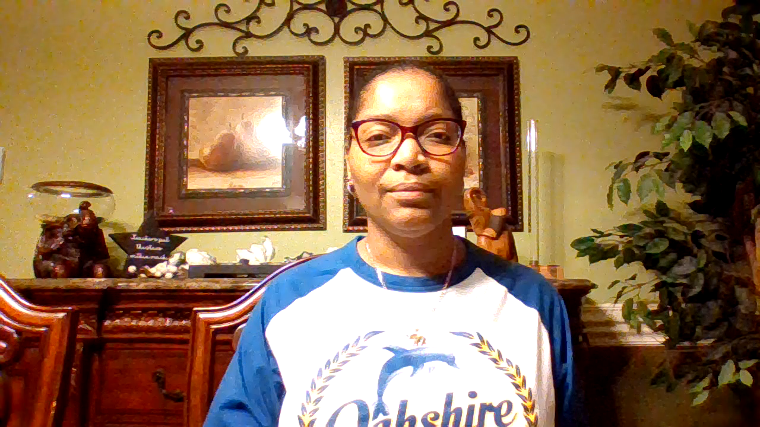
Rosalind Blake
Instructional Facilitator

Slide 2

Black History Month Benjamin Christopher Flores Jr.

Slide 3
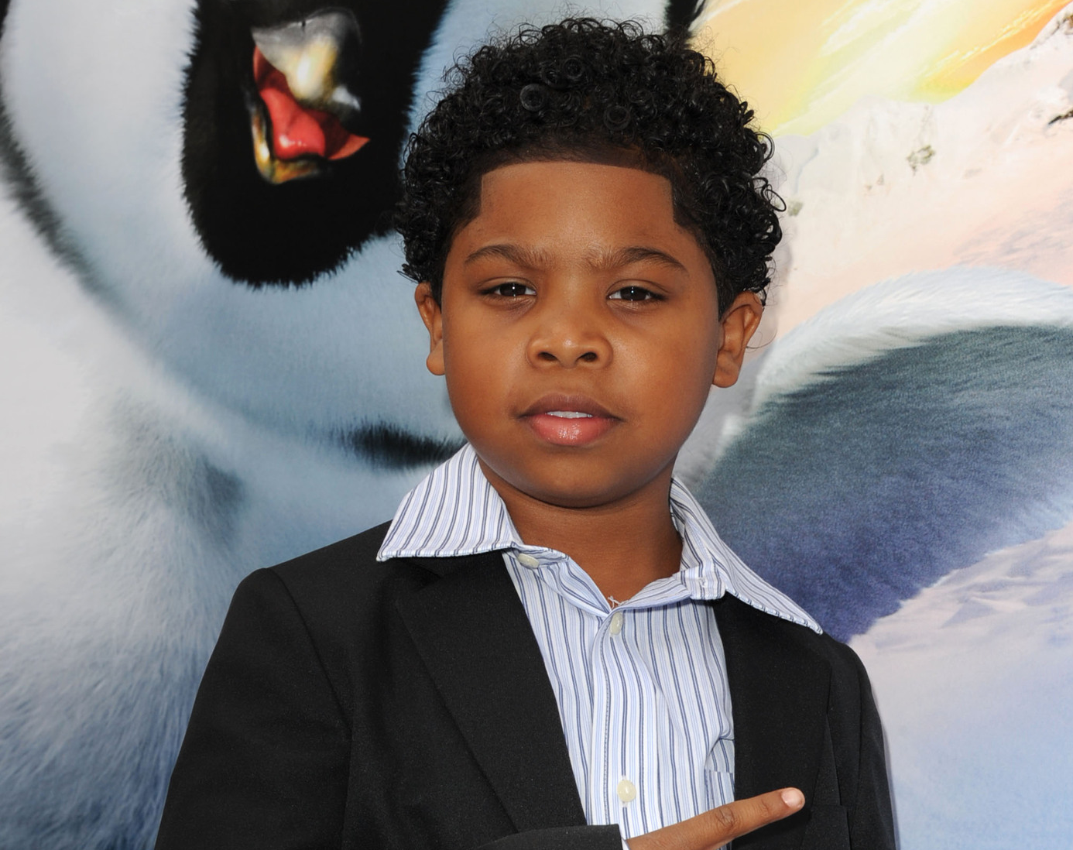
Benjamin Christopher Flores Jr

Slide 4
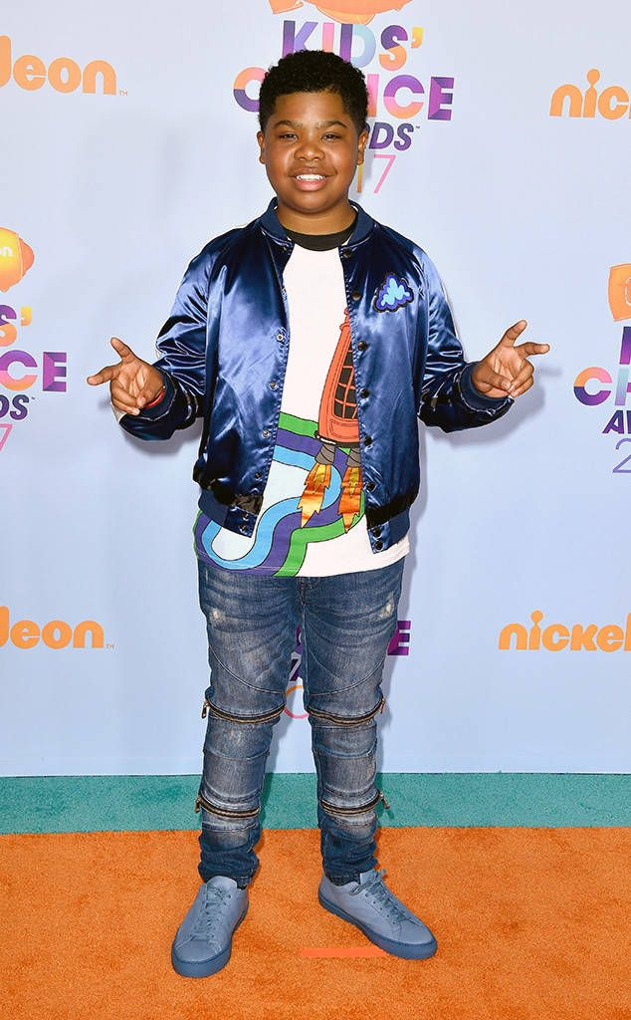
Benjamin Christopher Flores Jr. was born July 23, 2002, in Memphis, Tennessee. Also known as Lil' P-Nut, Flores is an American child actor and rapper.

Slide 5
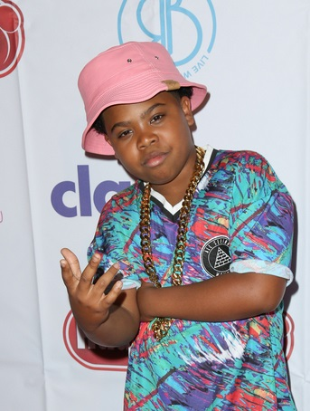
Flores first became known to a wider audience after he was interviewed by the local Memphis Fox 13 television station at age 7.
After that interview, he appeared on The Ellen DeGeneres Show, where he performed his first rap single as Lil' P-Nut, "You Might Be the One for Me"; it was released on September 25, 2010.

Slide 6

Flores appeared in an episode of the TBS sitcom Are We There Yet?, and played Atticus the rapping penguin in the animated film Happy Feet 2, in 2011. He made a cameo appearance in Yo Gotti's music video for "Look In The Mirror". Flores appeared in the film Ride Along, which was released in January 2014.

Slide 7
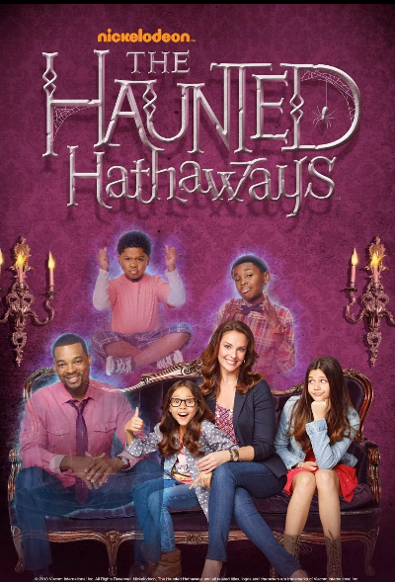
In 2013 Flores was cast in a starring role on the Nickelodeon television series The Haunted Hathaways, playing Louie, a young ghost that resides in the same house with a living family called the Hathaways. He was nominated for Favorite TV Actor at the Nickelodeon Kids' Choice Awards in 2014 and 2015 for his role on The Haunted Hathaways.

Slide 8

In 2015, it was announced that Flores would be co-starring in Dan Schneider's newest TV series, Game Shakers, playing the role of Triple G, the son of famous rapper Double G (Kel Mitchell).

Slide 9

In 2016, Flores was announced as the new voice of Gerald Johanssen in the television movie Hey Arnold!: The Jungle Movie. In 2017, he had a role in the fantasy-action film Transformers: The Last Knight. In 2018, Flores was cast in the Netflix film Rim of the World. He was cast to play Josh in the upcoming film Fear Street, which is set to be released on Netflix in mid-2021. On October 18, 2019, Flores was cast as Eugene Jones in the upcoming Showtime television series Your Honor.

Slide 10

If time permits, this is a 3 ½ minute clip of Benjamin Flores, Jr.-- Lil' P-Nut.

